Slide 1


Tableau Visualization Project
IBM HR dataset for attrition
This dataset analysis will help in finding the factors of attrition from which the employees are suffering.

Slide 2
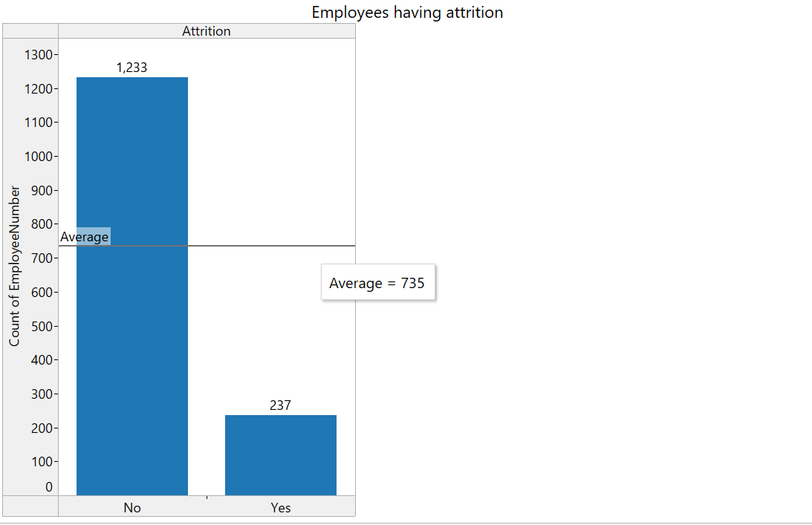
How many employees are suffering form attrition?

Slide 3
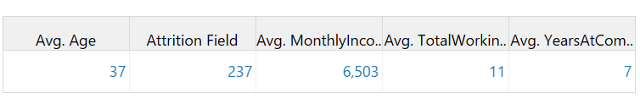
Create some key information in the form of KPI.

Slide 4
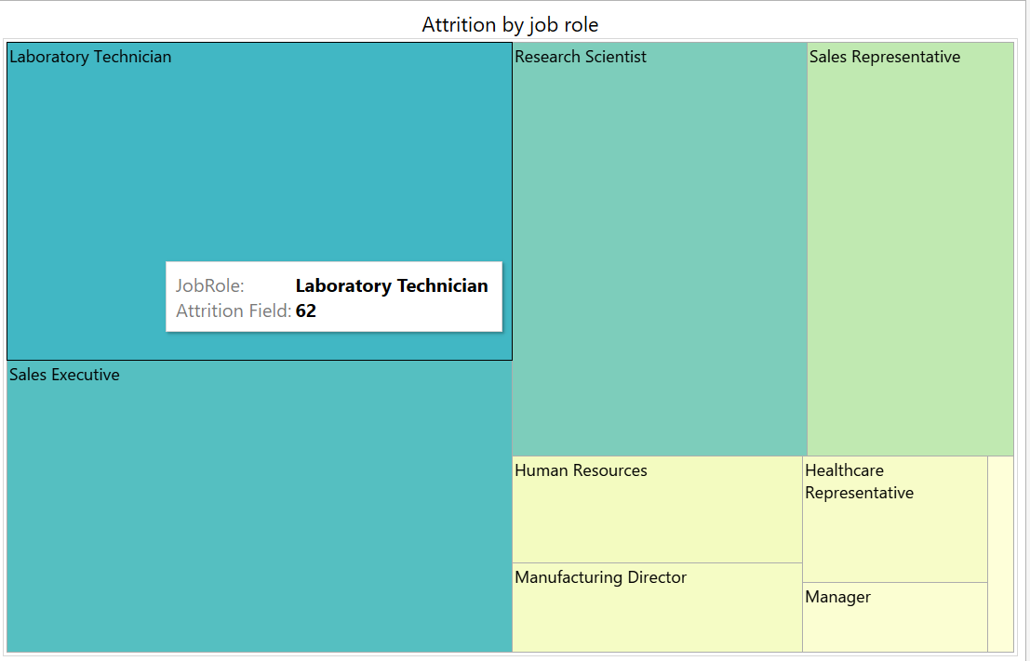
What is the attrition count according to the job role?

Slide 5
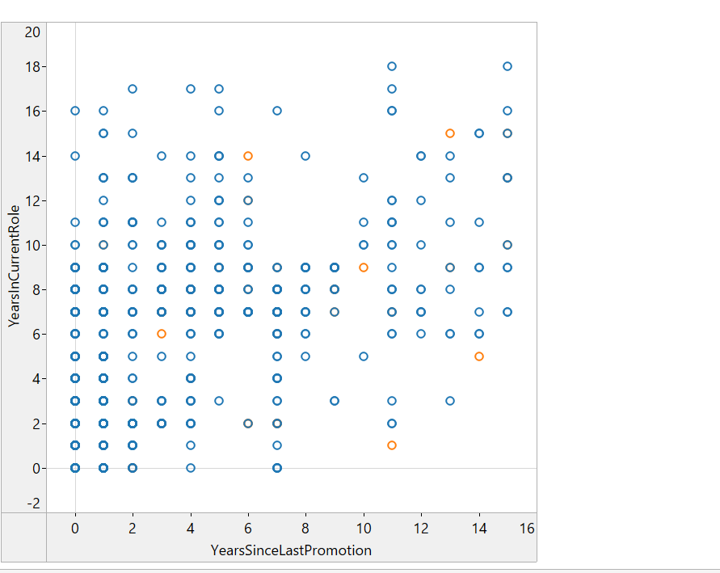
What is the Attrition count w.r.t years since last promotion and years in current role?

Slide 6
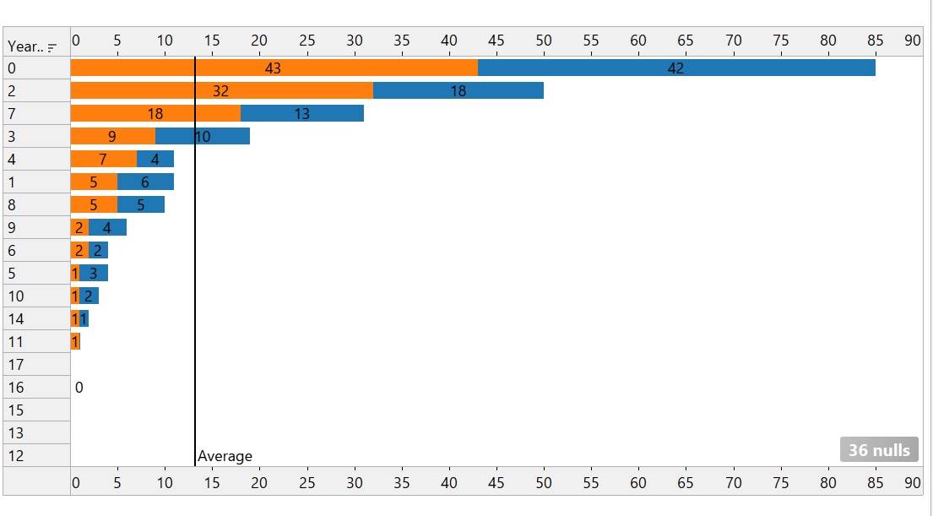
What is the attrition relation with the years with current manager?

Slide 7
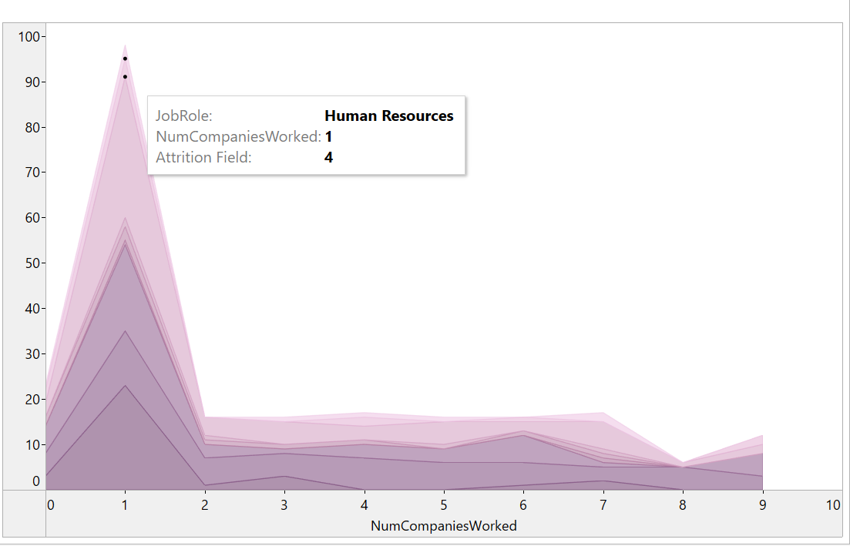
What is the attrition count according to the number of companies worked with job role?

Slide 8
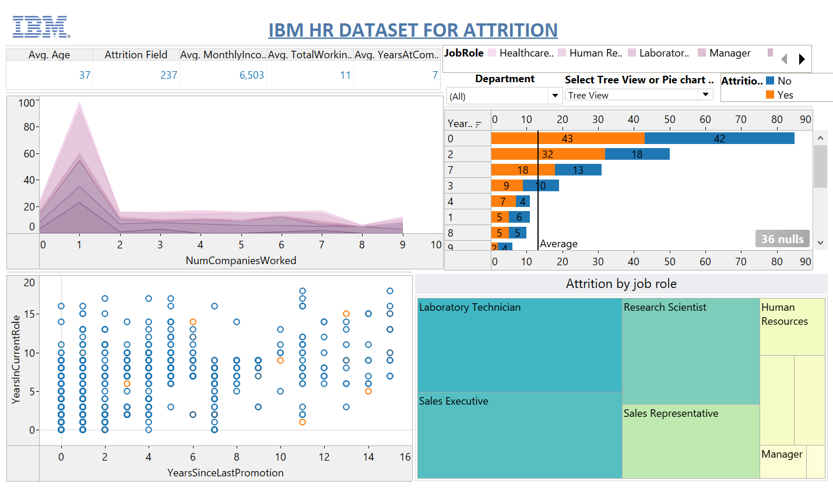
Main Dashboard

Slide 9
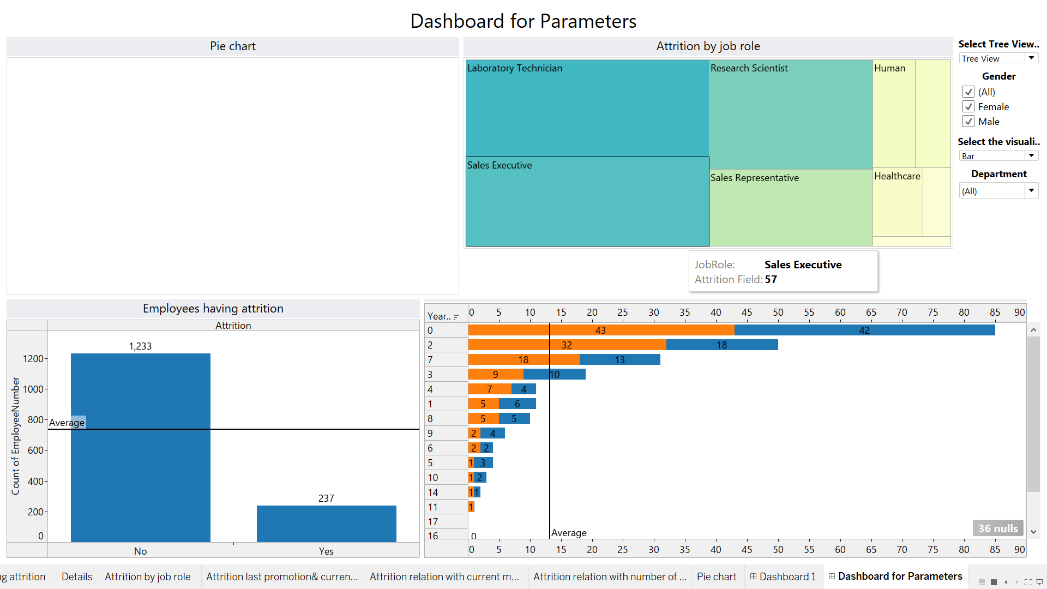
Dashboard for extra features

Slide 10
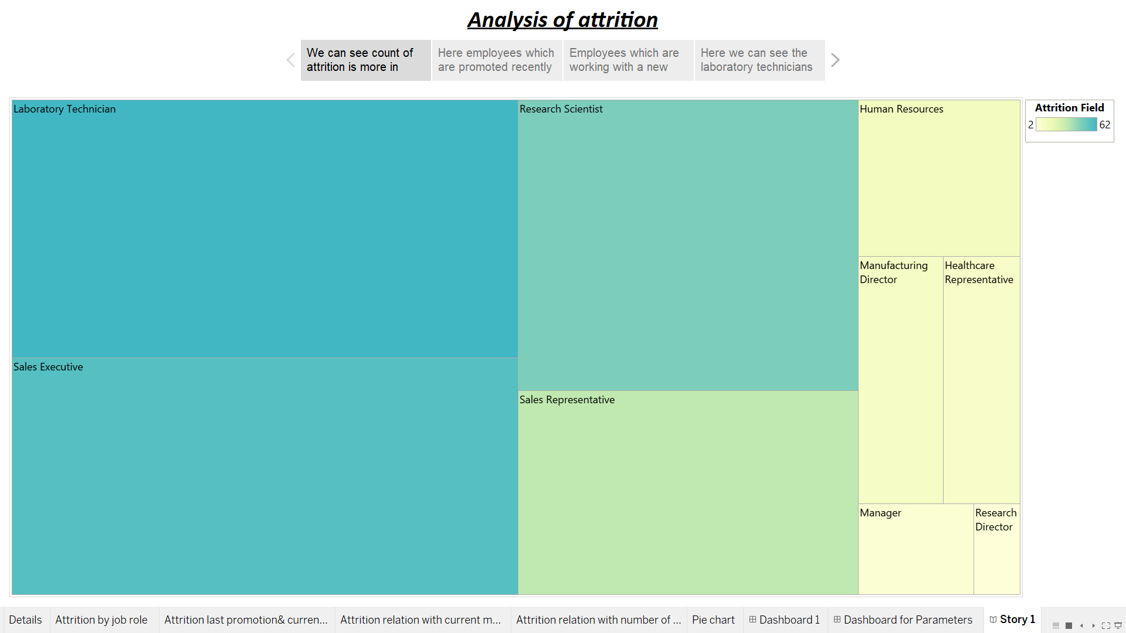
Story according to charts

Slide 11
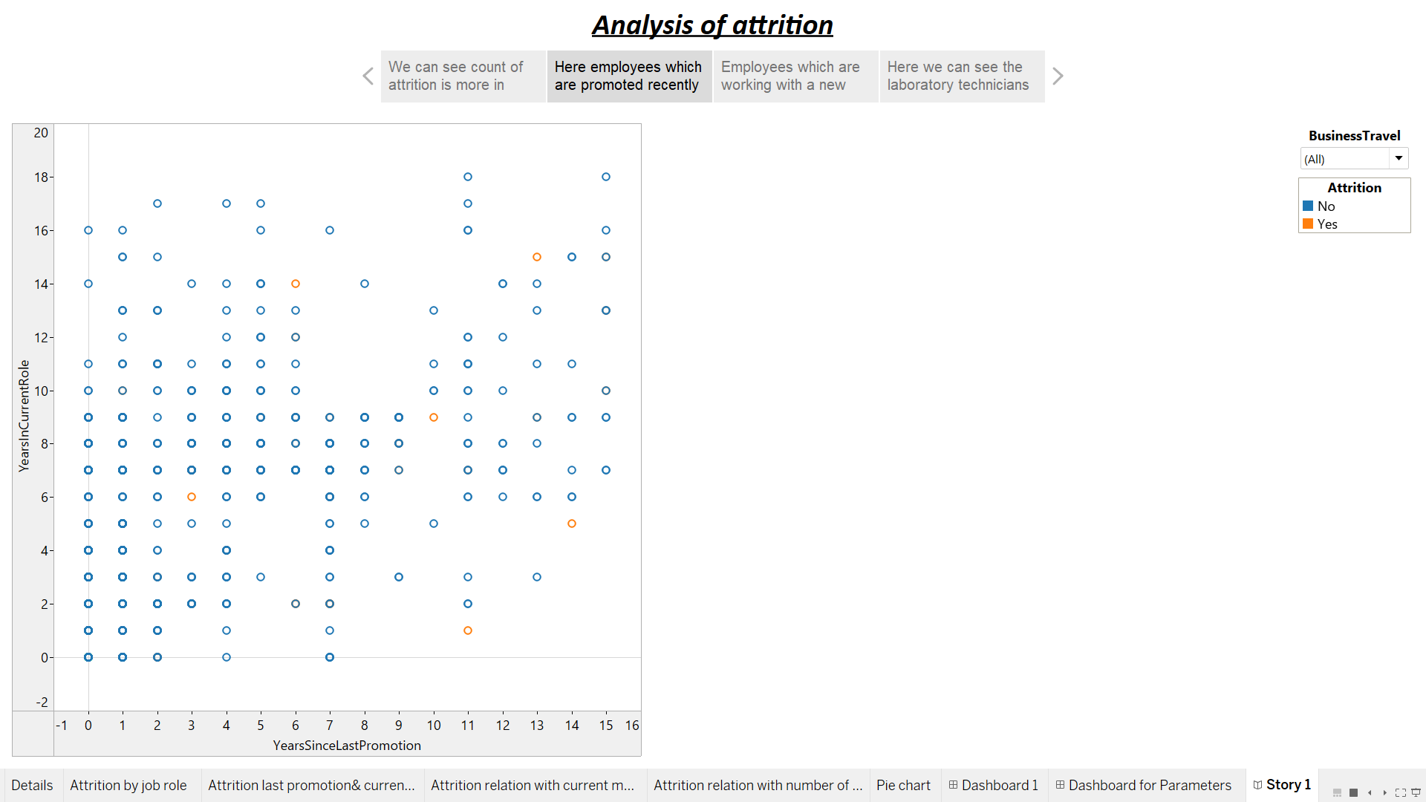

Slide 12
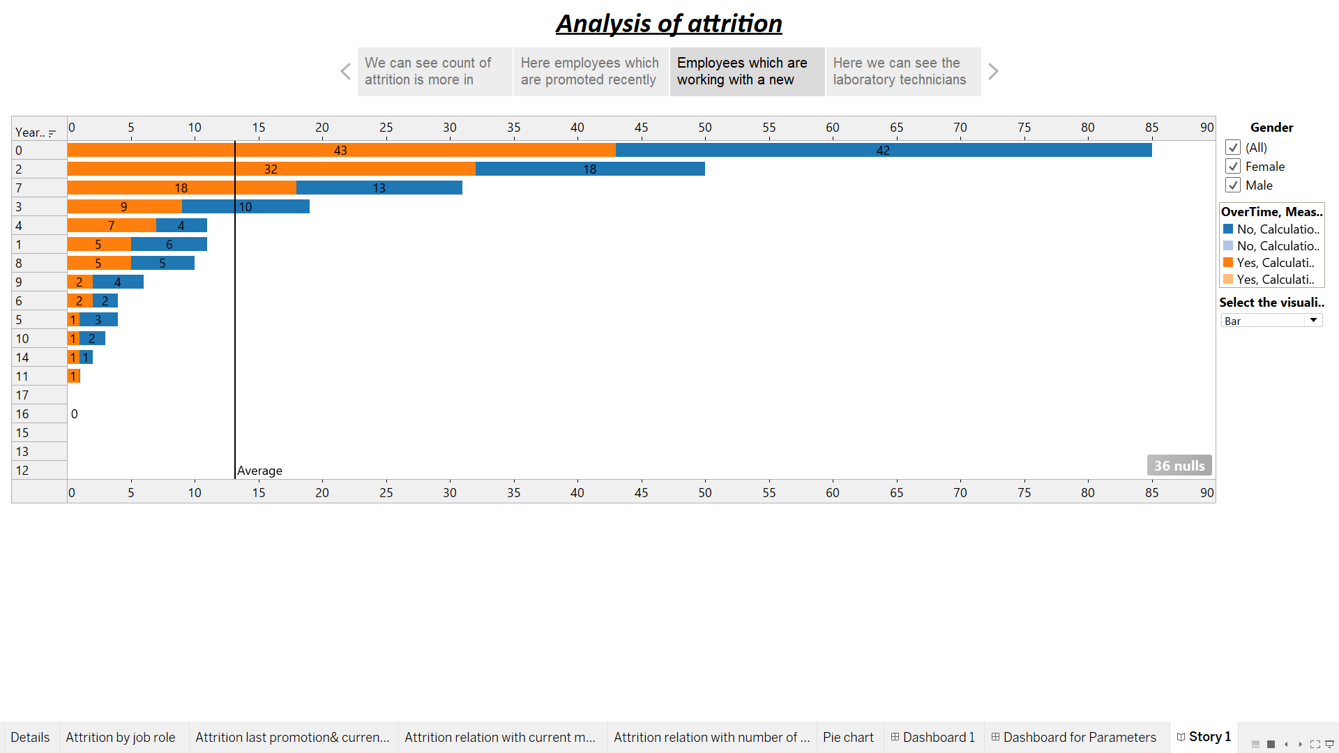

Slide 13
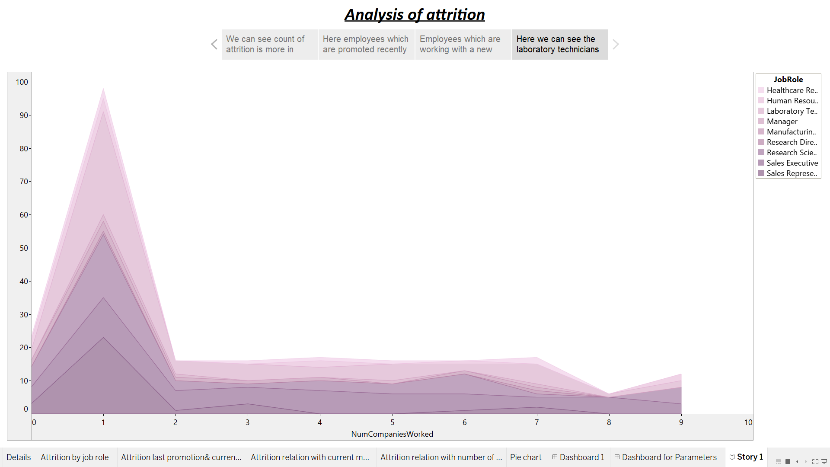

Slide 14
Conclusion
We can see most of the laboratory technicians are suffering form attrition as the attrition count is 62 in this job role.
We can see the employees which are promoted recently with a current job role are suffering form attrition. Even the employees lying in the mid range of the same graph are also suffering form the attrition. So, these could be some areas of concern.
In the last chart we can see most of the laboratory technicians with only one number of companies worked has the highest attrition count and by the time when the number of companies worked increase the attrition count decreases.

